Slide 1
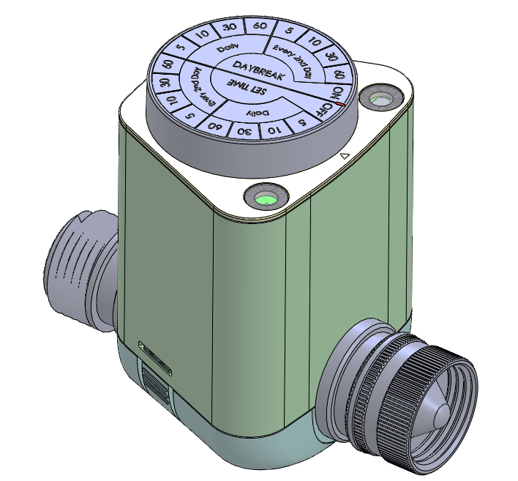
AP55
HT6 preliminary design proposal
Note: It is a preliminary design, and the valve is not yet confirm. The overall size and structure may change in the future.

Slide 2
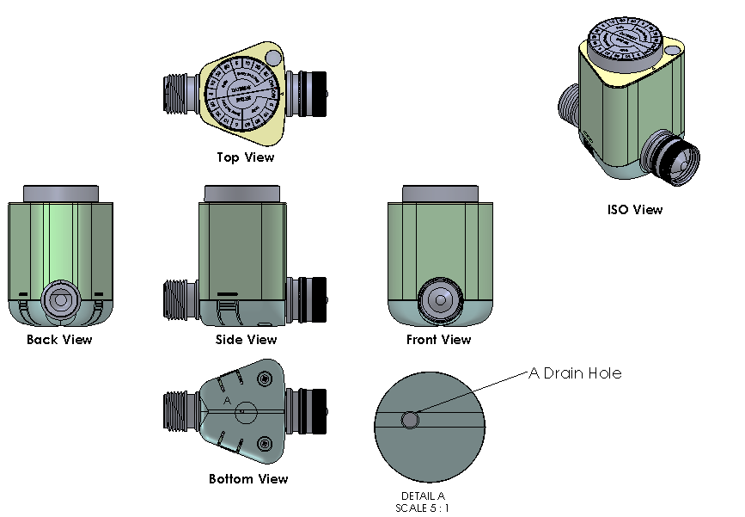
Outlook without LED version
It will use a black overlay with a transparent window to cover the photo sensor.
Note: It is a preliminary design, and the valve is not yet confirm. The overall size and structure may change in the future.

Slide 3
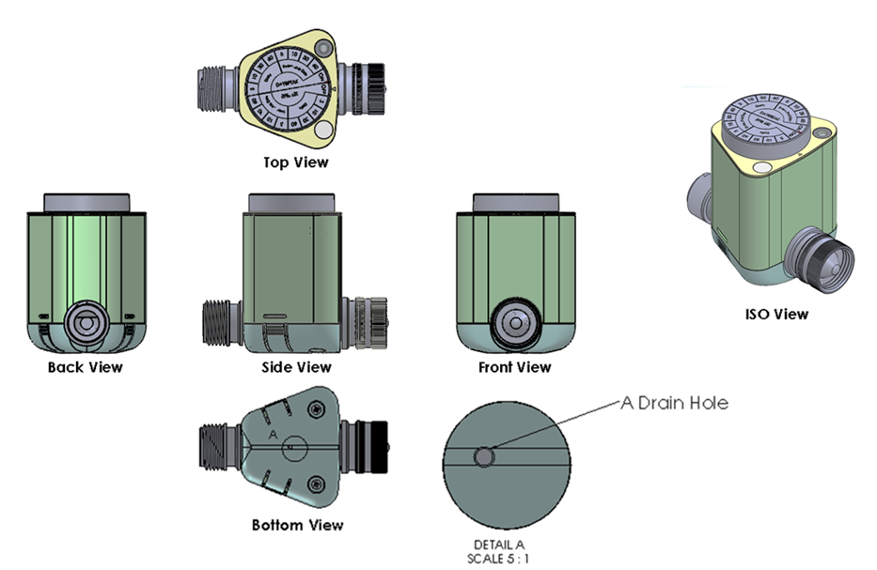
Outlook with LED version
The logo position will install the LED and it will have a translucent overlay to cover that.
But the logo need to re-position, would you consider put the logo on the knob sticker?
LED
Note: It is a preliminary design, and the valve is not yet confirm. The overall size and structure may change in the future.

Slide 4
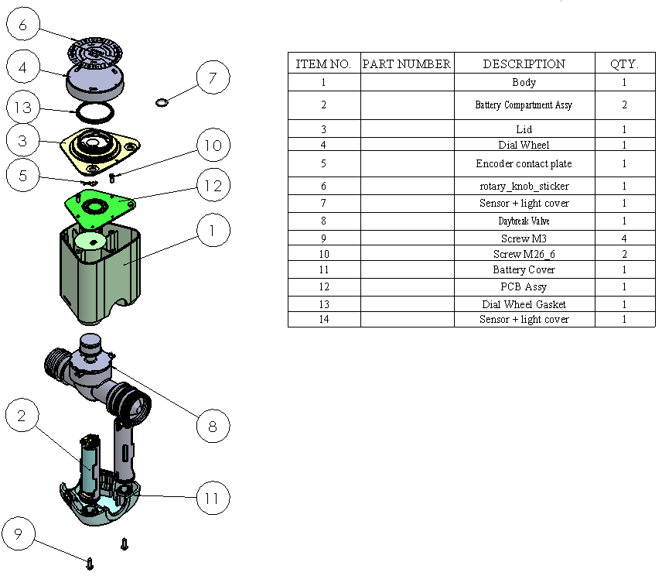
Exploded View
Note: It is a preliminary design, and the valve is not yet confirm. The overall size and structure may change in the future.

Slide 5
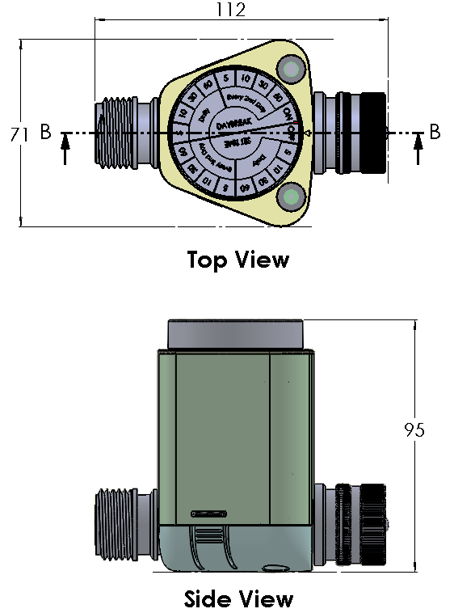
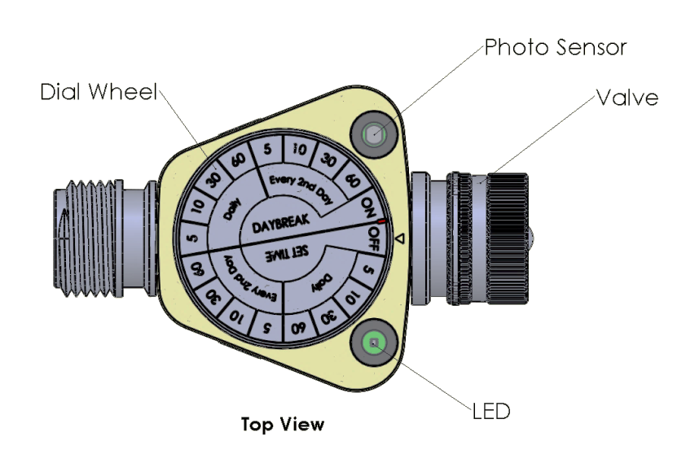
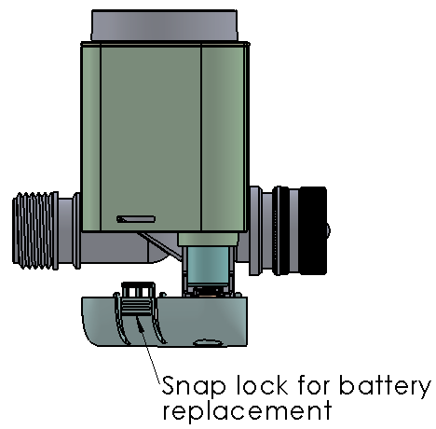
Indication & Outer dimension
Note: It is a preliminary design, and the valve is not yet confirm. The overall size and structure may change in the future.

Slide 6
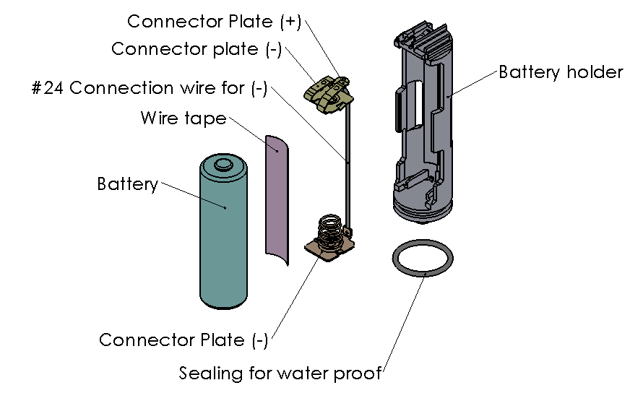
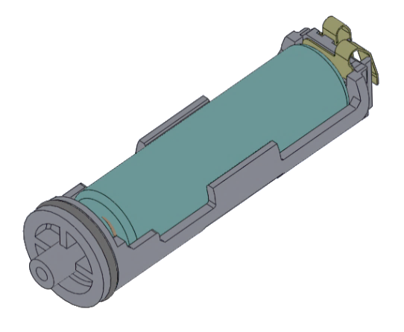

Battery Compartment 1/2
Note: It is a preliminary design, and the valve is not yet confirm. The overall size and structure may change in the future.

Slide 7
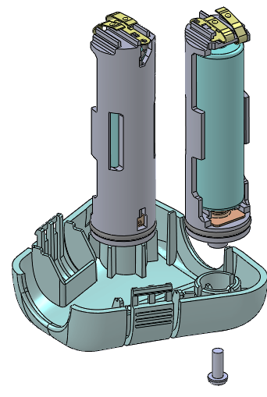
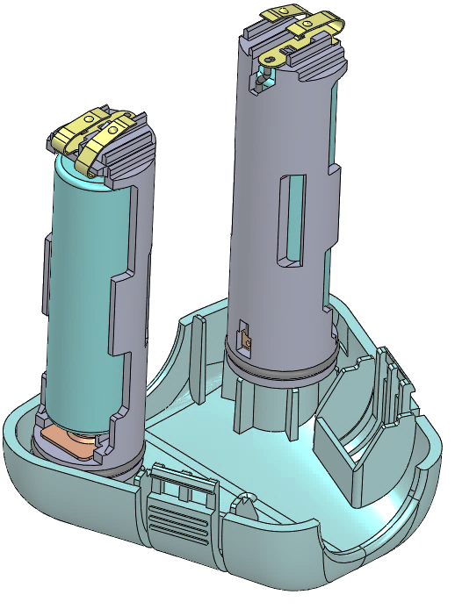
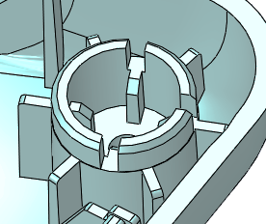
Battery Compartment 2/2
Bottom view on sub-Battery compartment
Bottom Housing
The sub-battery compartment will mount on bottom housing with screw to let it be a permanent part.
Three ribs on sub-battery compartment to guide the orientation during on assembly.
Battery compartment on finish good.
Note: It is a preliminary design, and the valve is not yet confirm. The overall size and structure may change in the future.

Slide 8
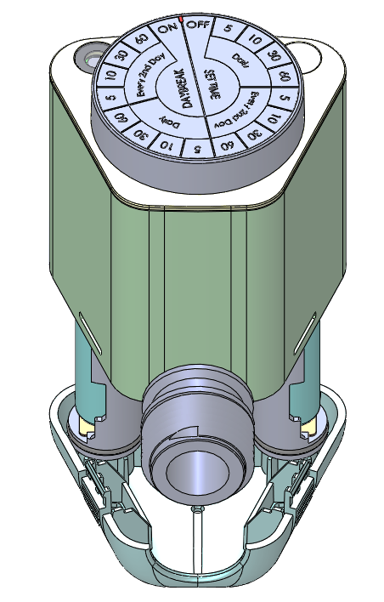
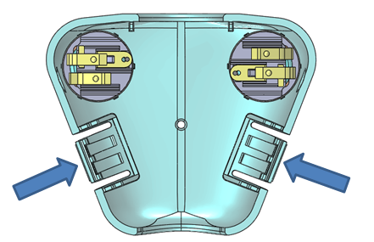
Battery replacement
Snap hook
Press the snap hook to take off the battery compartment.
Note: It is a preliminary design, and the valve is not yet confirm. The overall size and structure may change in the future.

Slide 9
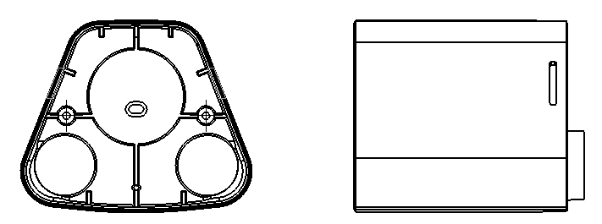
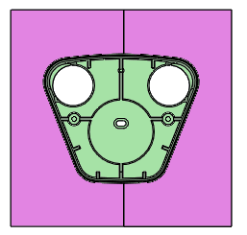
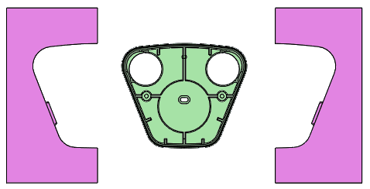
Body Analysis
We would like to keep the straight body, so the flat surface change to round surface for demolding.
The direction of snap hole is aligned the mold slider.
Preliminary analysis on mold structure:
Left Slider
Right Slider
open
Close
Note: It is a preliminary design, and the valve is not yet confirm. The overall size and structure may change in the future.

Slide 10
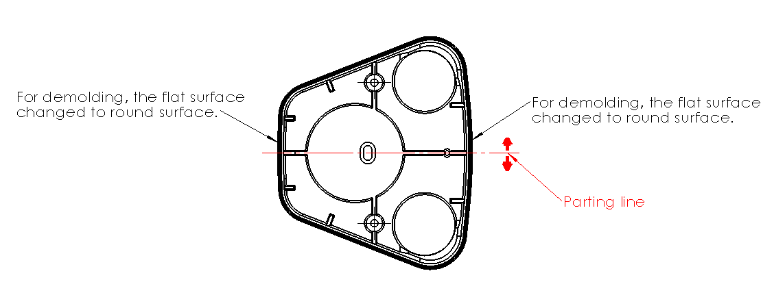
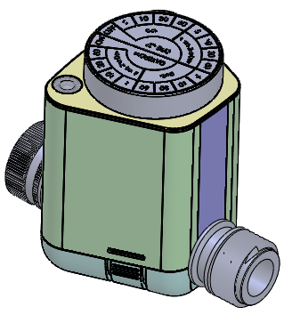
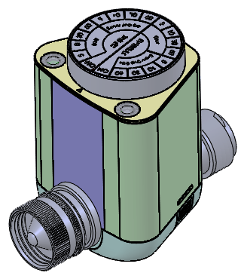
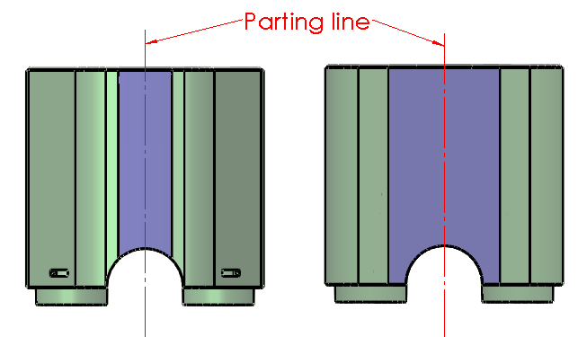
ID review
It will leave a parting line on round surface.
Note: It is a preliminary design, and the valve is not yet confirm. The overall size and structure may change in the future.

Slide 11
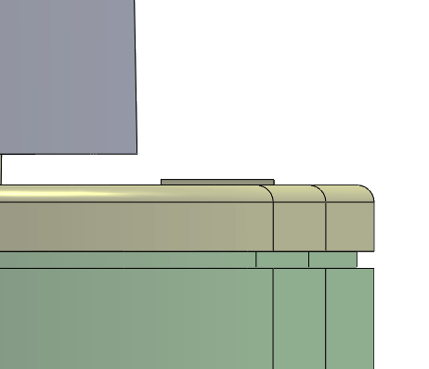
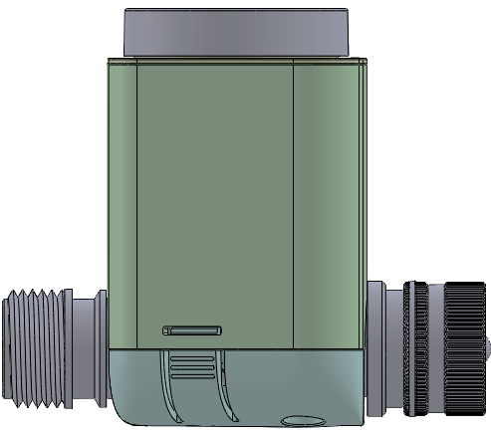
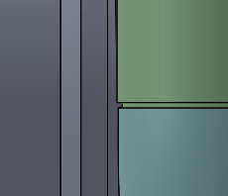
Decoration line
Here have around 0.3mm decoration line between the lid & body.
Here have around 0.3mm decoration line between the body & bottom housing.
Note: It is a preliminary design, and the valve is not yet confirm. The overall size and structure may change in the future.

Slide 12
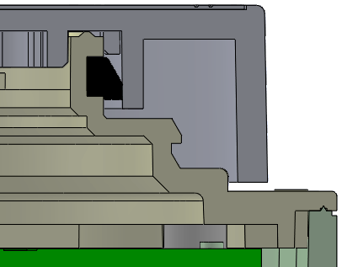
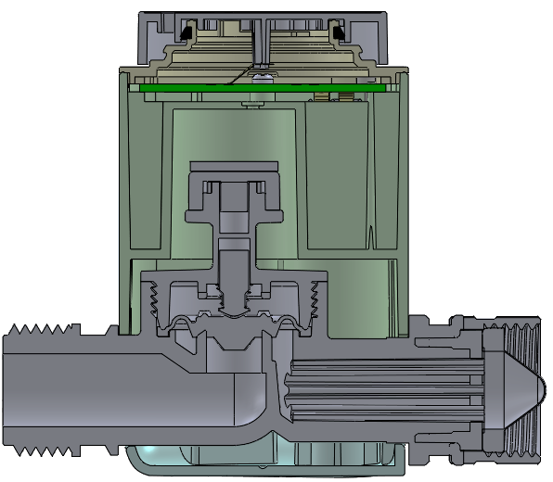
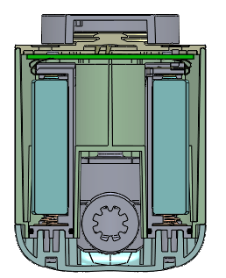
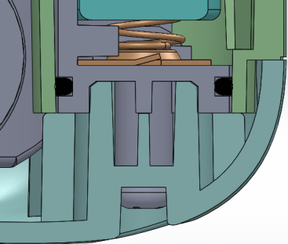
Waterproof
Sealing is between lid & dial wheel to meet the IP requirement.
The lid & body will combine with ultrasonic welding to meet the IP requirement.
Sealing used on battery compartment to meet the IP requirement.
Note: It is a preliminary design, and the valve is not yet confirm. The overall size and structure may change in the future.

Slide 13
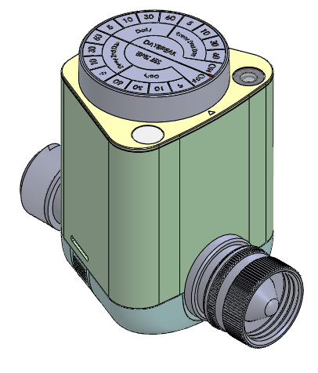
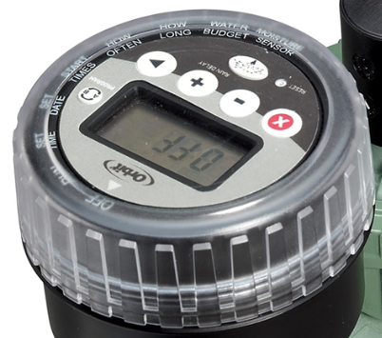
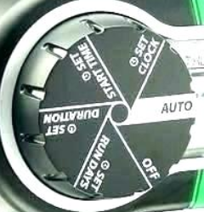
Suggestion
The current outer surface is a smoothing surface. Would you consider to add the detents on it?
Detents
Note: It is a preliminary design, and the valve is not yet confirm. The overall size and structure may change in the future.

Slide 14
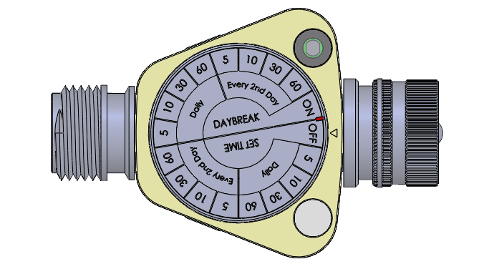
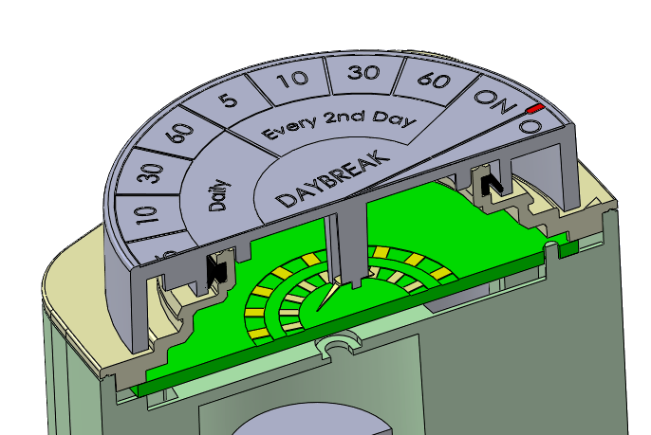
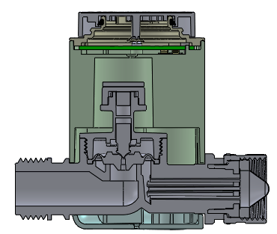
RGB Led on Arrow pointing
Arrow pointing
According to the latest product specification, the arrow pointing cannot add the LED, it is because it do not have enough space to add the light guide with ultrasonic welding.
Note: It is a preliminary design, and the valve is not yet confirm. The overall size and structure may change in the future.

